Slide 1
Course code : CSE3009 Course title : No SQL Data Bases Module : 2 Topic : 3
Columnar Data Model

Slide 2
Objectives
This session will give the knowledge about
Columnar Data Model

Slide 3
Columnar Data Model
In column-oriented NoSQL database, data is stored in cells grouped in columns of data rather than as rows of data.
Columns are logically grouped into column families.
Column families can contain a virtually unlimited number of columns that can be created at runtime or the definition of the schema.
Read and write is done using columns rather than rows.
It can scale to manage large volumes of data

Slide 4
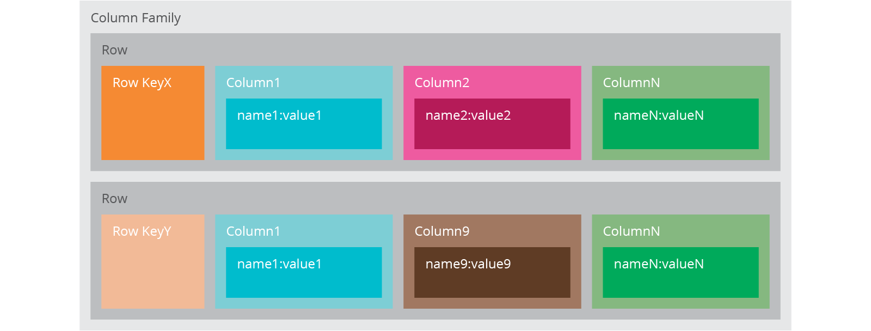
Columnar Data Model

Slide 5
Columnar Data Model
Column-family databases store data in column families as rows that have many columns associated with a row key as mentioned in previous Fig.
Each column family can be compared to a container of rows in an RDBMS table where the key identifies the row and the row consists of multiple columns.
The difference is that various rows do not have to have the same columns, and columns can be added to any row at any time without having to add it to other rows.

Slide 6
Columnar Data Model
When a column consists of a map of columns, then we have a super column.
A super column (container of columns) consists of a name and a value which is a map of columns.
Cassandra is one of the popular column-family databases.
Cassandra can be described as fast and easily scalable with write operations spread across the cluster.
The cluster does not have a master node, so any read and write can be handled by any node in the cluster.

Slide 7
Columnar Data Model
ColumnFamily: ColumnFamily is a single structure that can group Columns and SuperColumns with ease.
RowKey: the permanent name of the record. Keys have different numbers of columns, so the database can scale in an irregular way.
Keyspace: This defines the outermost level of an organization, typically the name of the application. For example, ‘InfosysDataBase’ (database name).
Column: It has an ordered list of elements as tuple with a name and a value defined.

Slide 8
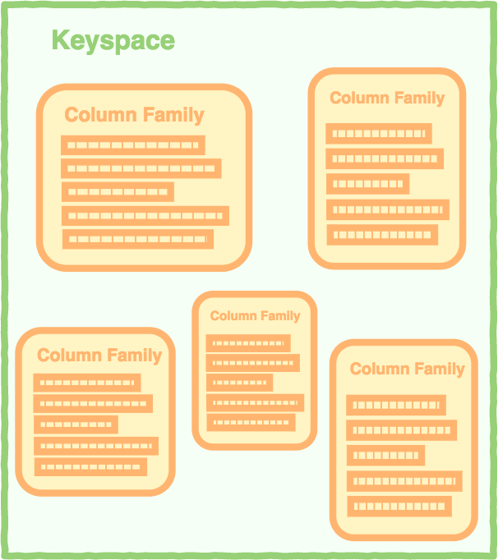
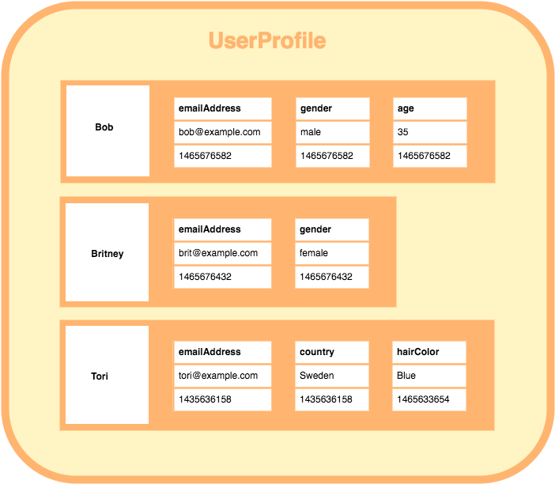
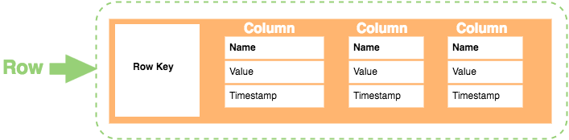
Columnar Data Model
A keyspace containing A column family containing how each row is constructed
column families. 3 rows. Each row contains its
own set of columns.

Slide 9
Columnar Data Model
Here’s a breakdown of each element in the row:
Row Key: Each row has a unique key, which is a unique identifier for that row.
Column: Each column contains a name, a value, and timestamp.
Name: This is the name of the name/value pair.
Value: This is the value of the name/value pair.
Timestamp: This provides the date and time that the data was inserted. This can be used to determine the most recent version of data.

Slide 10
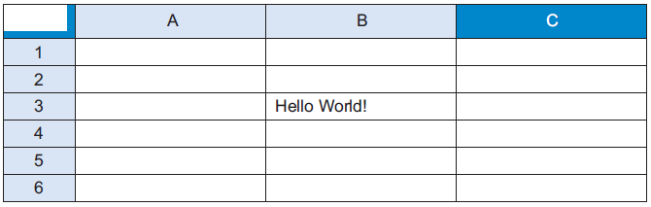


Column family basics
Using a row and column to address a cell. Spreadsheets use a row
column pair as a key to
look up the value of a cell.
In Column family stores

Slide 11
Columnar Data Model - Example
The best known examples are Google’s BigTable and HBase & Cassandra that were inspired from BigTable.
For example, a Geographic Information System (GIS) like Google Earth might have a row ID for the longitude portion of a map and use the column name for the latitude of the map.
If you have one map for each square mile on Earth, you could have 15,000 distinct row IDs and 15,000 distinct column IDs.

Slide 12
Columnar Data Model - Example
BigTable, is a high performance, compressed and proprietary data storage system owned by Google. It has the following attributes:
Sparse – some cells can be empty
Distributed – data is partitioned across many hosts
Persistent – stored to disk
Multidimensional – more than 1 dimension
Map – key and value
Sorted – maps are generally not sorted but this one is

Slide 13
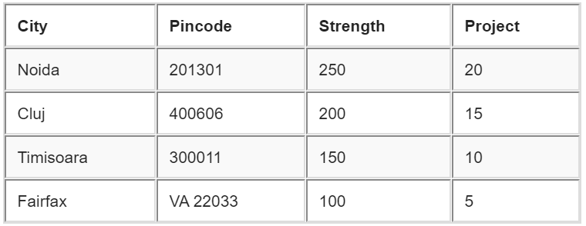
Columnar Data Model - Example
A 2-dimensional table comprising of rows and columns is part of the relational database system.

Slide 14
Columnar Data Model - Example
For previous RDBMS table a BigTable map can be visualized as shown below.
{
InfosysNoida: {
address: {
city: Noida
pincode: 201301
},
details: {
strength: 250
projects: 20
}
}
{
InfosysCluj: {
address: {
city: Cluj
pincode: 400606
},
details: {
strength: 200
projects: 15
}
},
{
InfosysTimisoara: {
address: {
city: Timisoara
pincode: 300011
},
details: {
strength: 150
projects: 10
}
}
{
InfosysFairfax : {
address: {
city: Fairfax
pincode: VA 22033
},
details: {
strength: 100
projects: 5
}
}

Slide 15
Columnar Data Model - Example
The outermost keys InfosysNoida, InfosysCluj, InfosysTimisoara and InfosysFairfax are analogues to rows.
‘address’ and ‘details’ are called column families.
The column-family ‘address’ has columns ‘city’ and ‘pincode’.
The column-family details’ has columns ‘strength’ and ‘projects’.
Columns can be referenced using CloumnFamily.
Google’s BigTable, HBase and Cassandra are the most popular column store based databases.

Slide 16
Columnar Data Model – Example in Cassandra
Insert into InfosysNoida.address(city,pincode) values(‘Noida’,201301);
Insert into InfosysNoida.details(strength,projects) values(250,20);
Update InfosysNoida.address Set city=‘UP‘ Where pincode=201301;
Delete from InfosysNoida.address where pincode=201301;

Slide 17
Benefits of Column Store Databases
The column family approach of using a row ID and column name as a lookup key is a flexible way to
store data,
gives you benefits of higher scalability and availability, and
saves you time and hassles
when adding new data to your system.
Column family systems have automatic failover built in to detect failing nodes and algorithms to identify corrupt data.
The advanced hashing and indexing tools such as Bloom filters are used in column data stores to perform probabilistic analysis on large data sets.

Slide 18
Benefits of Column Store Databases
Higher scalability:
Column family systems are scalable by nature. You can add more data to your system, you can add more cluster to the computing cluster.
Higher availability:
The server that holds part of the sparse matrix crashes, other computers are available to provide the data service for those cells. Because
column family systems use efficient communication, the cost of replication is lower
the lack of join operations allows you to store any portion of a column family matrix on remote computers

Slide 19
Benefits of Column Store Databases
Easy to add new data
Like the key-value and graph stores, a key feature of the column family store is that you don’t need to fully design your data model before you begin inserting data.
But there are a couple constraints:
Your groupings of column families should be known in advance, but row IDs and column names can be created at any time.
Column family systems also don’t support standard SQL queries for real-time data access. They may have higher-level custom API written in a procedural language.

Slide 20
Benefits of Column Store Databases
Some other key benefits of columnar databases include:
Compression: Column stores are very efficient at data compression and/or partitioning.
Aggregation queries: Due to their structure, columnar databases perform particularly well with aggregation queries (such as SUM, COUNT, AVG, etc).
Fast to load and query: Columnar stores can be loaded extremely fast. A billion row table could be loaded within a few seconds. You can start querying and analyzing almost immediately.

Slide 21
Summary
This session will give the knowledge about
Columnar Data Model

